Slide 1
Moving to toronto
Where to Eat?
Ashish Bajracharya

Slide 2
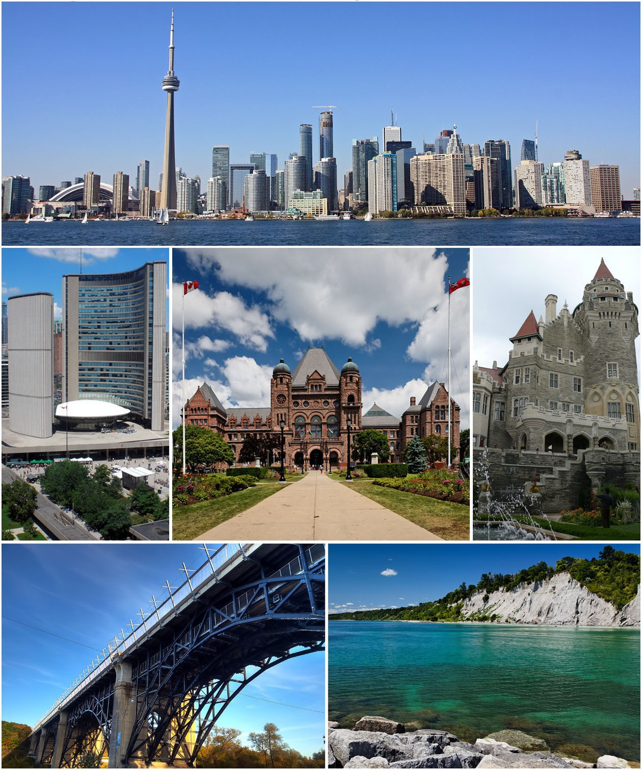
Outline
Introduction
Data
Methodology
Results and Observations
Conclusion

Slide 3
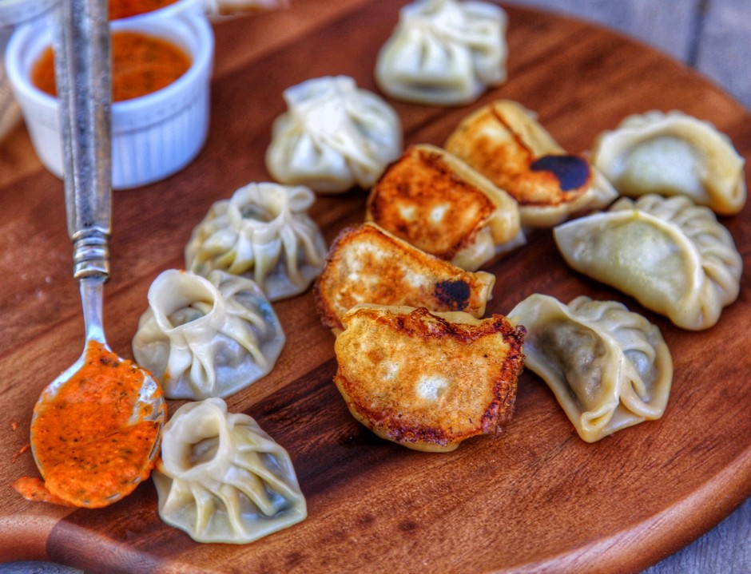
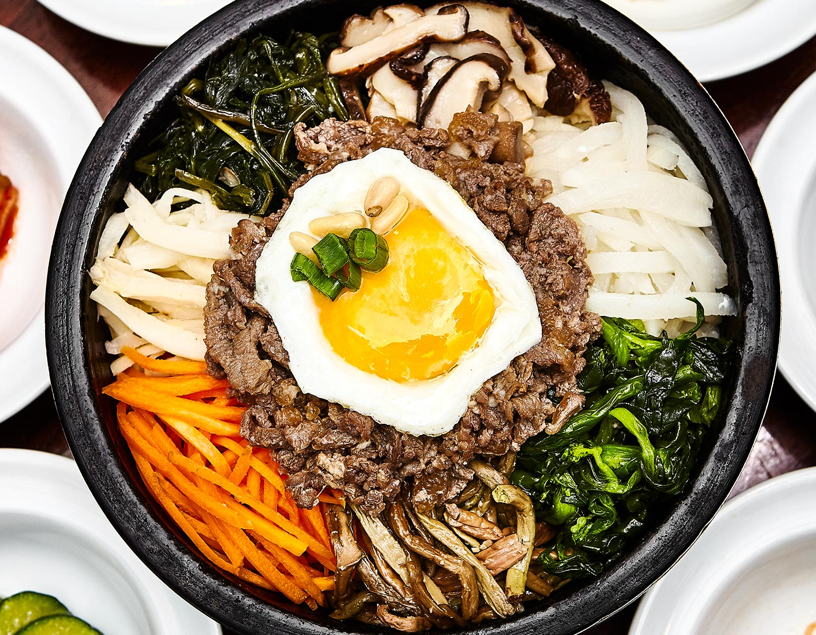
Introduction
Family currently living in Dallas, TX
Relocating to Toronto
Enjoy eating cuisines from across the globe, especially Nepalese, Korean, Chinese and Japanese
Dallas has plenty of eating options
Not familiar with Toronto and no friends or family there
Explore to see what kind of cuisines are available in Toronto
Might help determine where to move in Toronto

Slide 4
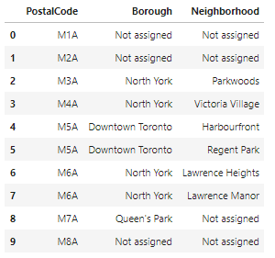
Data
Wikipedia for different boroughs and neighborhoods in Toronto
Foursquare to find different venues in the neighborhoods

Slide 5
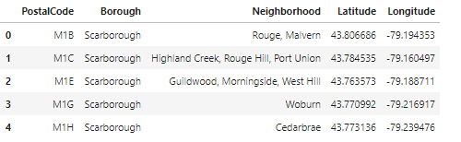
Methodology
Several Postal Codes have Borough and Neighborhood “Not Assigned”
Removing those rows and grouping by Postal Code
Getting longitudes and latitudes for Neighborhoods and merging with data frame

Slide 6
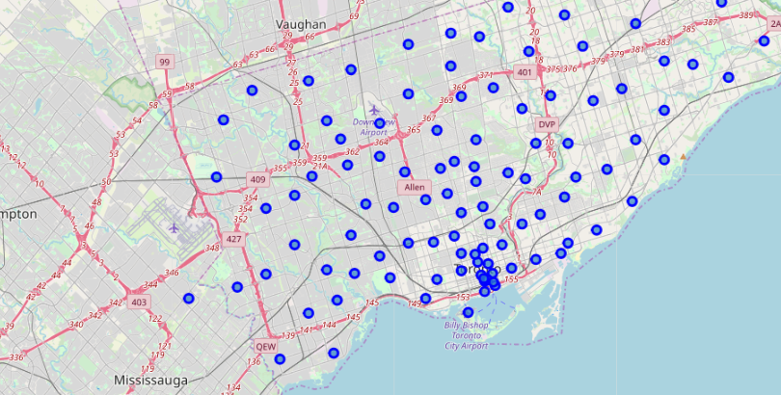
Visualizing Toronto Neighborhoods

Slide 7
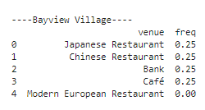
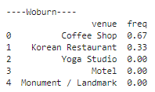
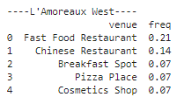
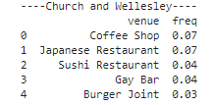
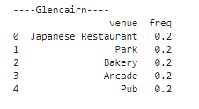
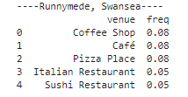
Results and Observations

Slide 8
Conclusion
Scarborough seems to be the borough which offers the kind of cuisine my wife and I are interested in
Presence of Indian, Vietnamese, Chinese and Latin American restaurants
We would look for an apartment in one of the neighborhoods in Scarborough

